Slide 1

Predicting Amazon Stock Prices Using Linear Regression
Subtitle: A Machine Learning Approach
Presenters Name: [Anjanpalage Fernando,,]
Date: [05.21.2024]

Slide 2

Introduction
Objective: To predict Amazon stock prices using historical data and linear regression
Key Steps: Data Collection
- Data Preprocessing
- Model Building and Training
- Model Evaluation
- Prediction and Forecasting

Slide 3
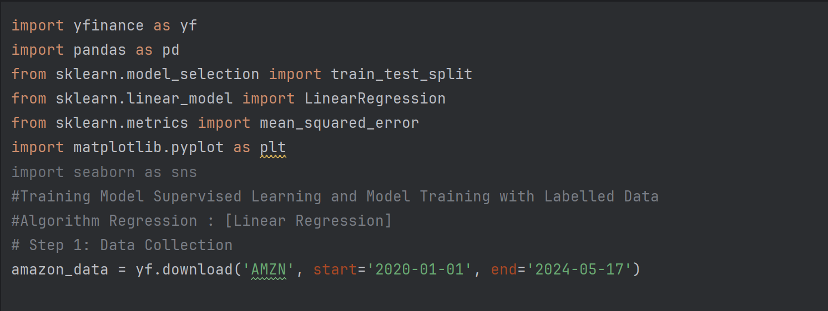
Data Collection
-‘yfinance’ is a Python library used for accessing financial data from Yahoo Finance
Key Feature of ‘yfinance’
+ Historical Market Data
+ Ticker Information
+ Easy to use API
+ Real- Time Data

Slide 4
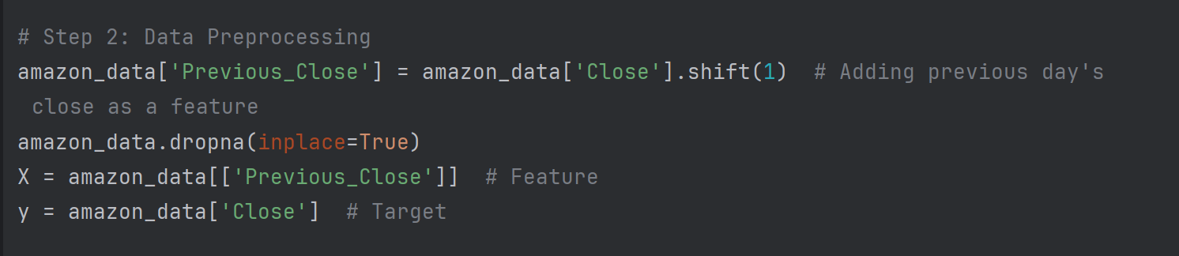
DATA PREPROCESSSING
Preprocessed data by adding previous day's close price as a feature.

Slide 5
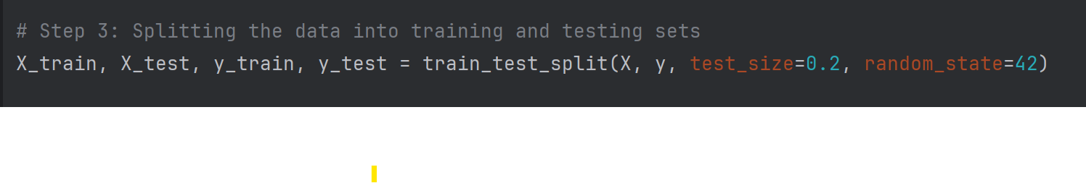
Splitting the Data
Split the data into training and testing sets.

Slide 6
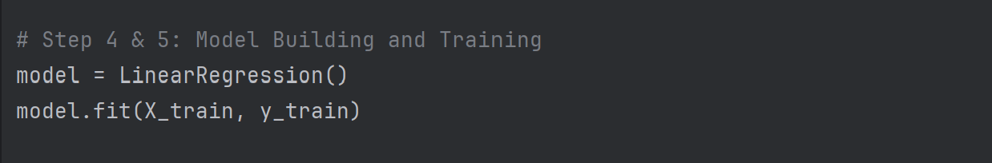
Model Building and Training
Built and trained a linear regression model.

Slide 7
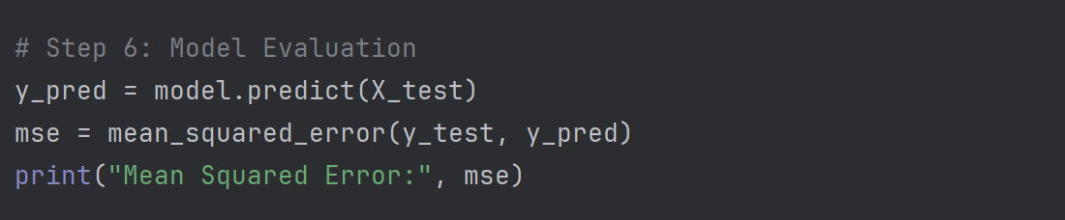
Model Evaluation
Evaluated the model using Mean Squared Error (MSE).
Result: Mean Squared Error: [MSE Value]

Slide 8
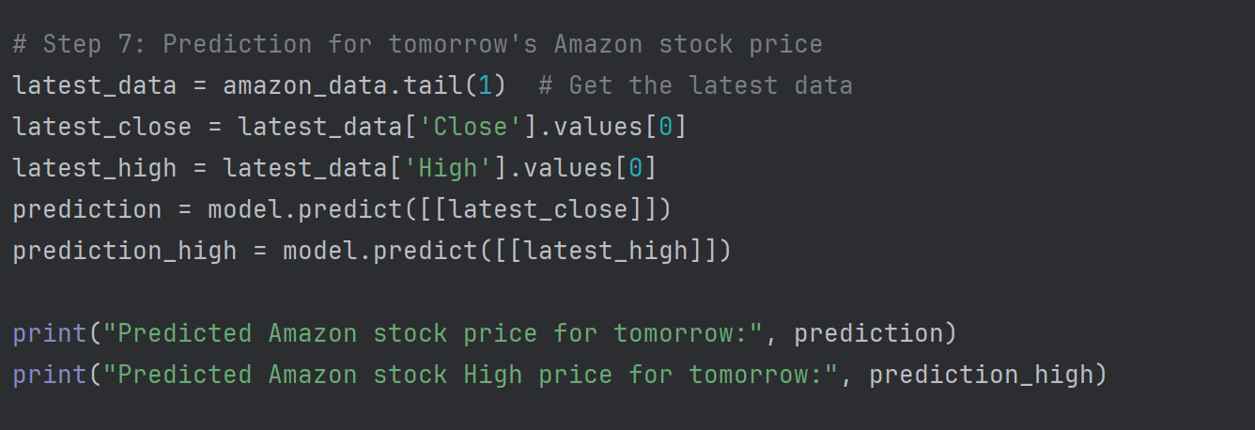
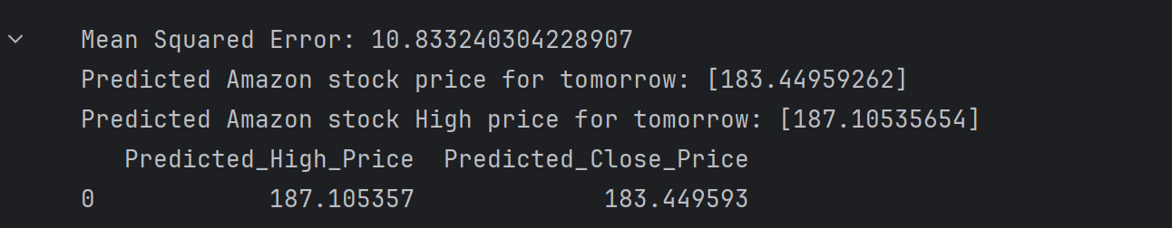
Prediction for Tomorrow
Predicted Amazon stock price for the next day.

Slide 9
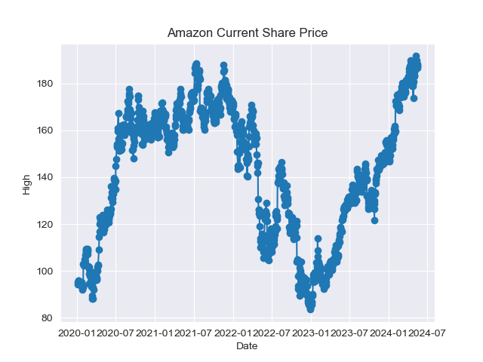
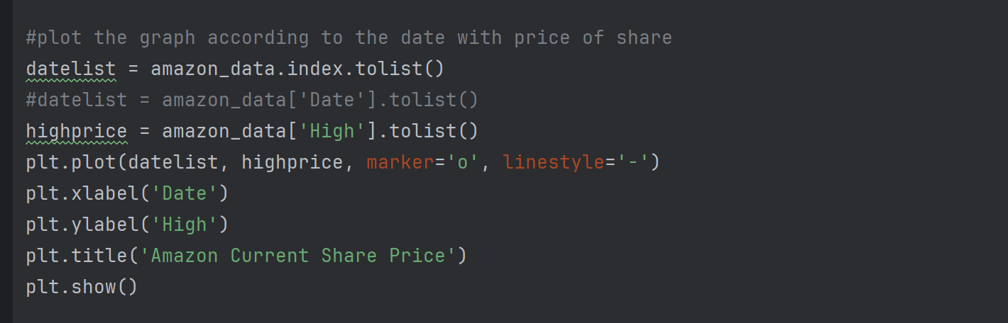
Plotting Historical High Prices
Visualized Amazon's historical high prices.

Slide 10
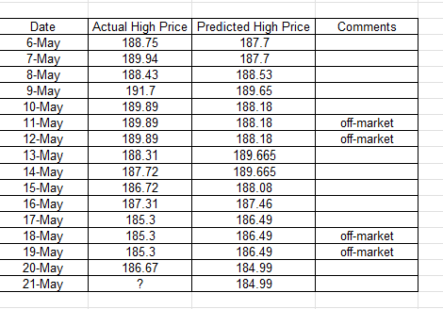
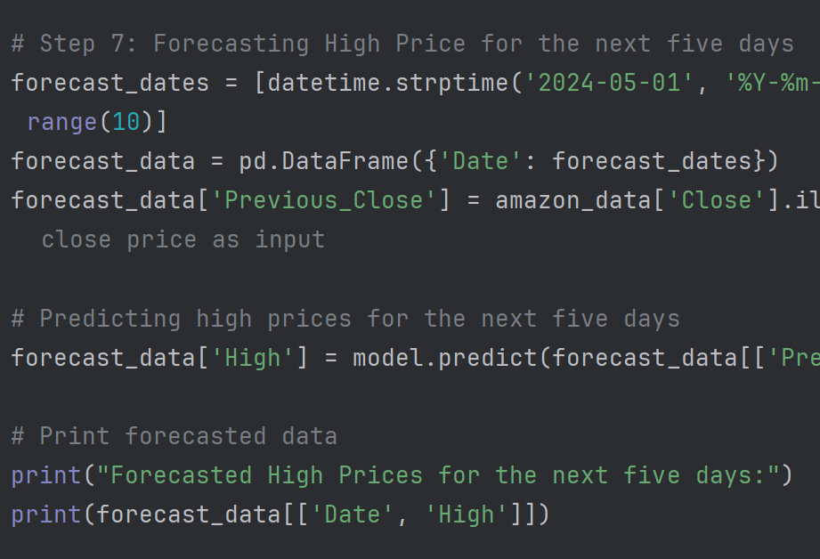
Forecasting Future Prices
Forecasted high prices for the next five days.

Slide 11
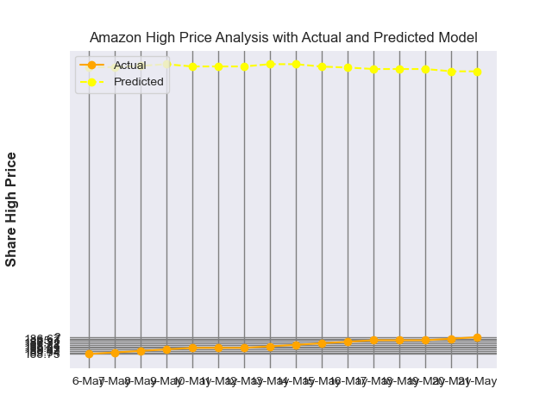
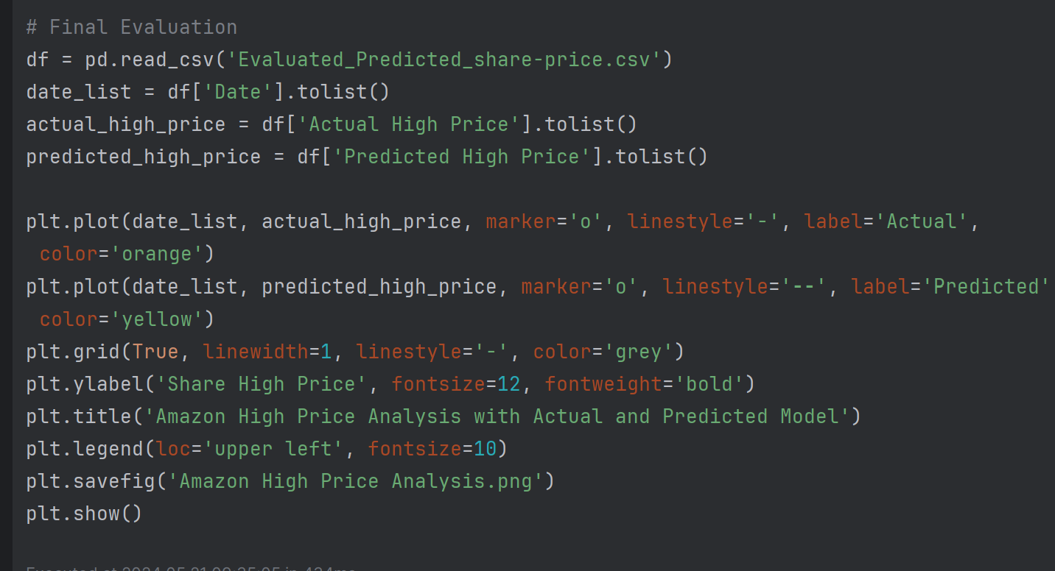
Data Clean For Final Analys

Slide 12

Final Conclution
About MSE(Mean Square Error)
In Our Case How it fit with the Model

Slide 13

Significance of Mean Squared Error (MSE)
Accuracy Measure: The MSE is calculated by taking the average of the squared differences between the actual (observed) values and the predicted values.
** IN Our Project
-Accuracy Measure:
MSE quantifies the difference between the predicted stock prices and the actual stock prices from your test dataset.
A lower MSE indicates that your model's predictions are closer to the actual values, suggesting better accuracy.

Slide 14
In Our case, an MSE of 12 for predicting Amazon's stock prices can be considered good, but the interpretation depends on several factors:
Factors to Consider:
Scale of the Target Variable:
-Amazon's stock prices typically range in the hundreds to thousands of dollars.
- An MSE of 12, which corresponds to a Root Mean Squared Error (RMSE) of approximately 12≈3.46\sqrt{12} approx. 3.4612​≈3.46, means that, on average, your model's predictions are about $3.46 off from the actual stock prices.
Comparison to Baseline Models:
MSE is significantly lower than the baseline model, it indicates that your model is performing better.
- Historical Performance

Slide 15

Conclusion:
Based on the factors above:
An MSE of 12 for predicting Amazon's stock prices can generally be considered good, especially given the scale of the stock prices.
It suggests that your model's predictions are relatively close to the actual stock prices.
However, always consider the specific context of your project and how this level of error fits with your requirements and expectations.

